Slide 1
Can Machine Write？ Chinese Fonts Generation via Recurrent Neural Network
Team Name: Bug Killer Team
Slice by Yang Hu, Jiahao Xu, Xiaohan Yu

Slide 2
Chinese Fonts Generation
Handling characters have attracted intensive attentions recent years, among which the following two topics are most popular: character recognition and glyph synthesis, corresponding to the two basic skills of humans: reading and writing.
Despite the development of deep learning networks, Chinese font generation is still a rather challenging task.

Slide 3
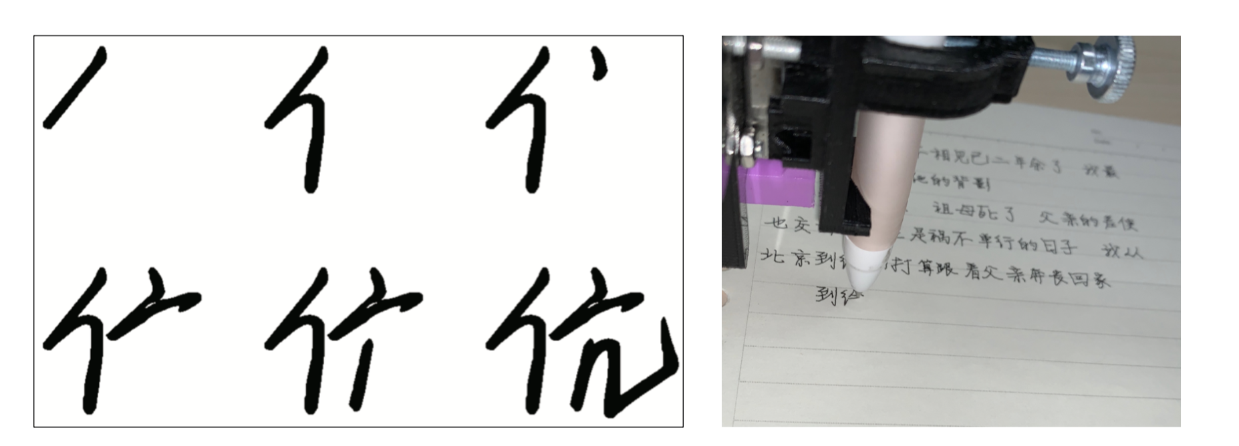
Chinese Fonts Generation
Most proposed models focus on the image-level features, utilize CNN to generate bitmaps, for example, cycle GAN.
Chinese characters are naturally consist of several strokes and they should be written in a specific order.
We focus on the temporal-level features, treat Chinese characters as sequences of points.

Slide 4
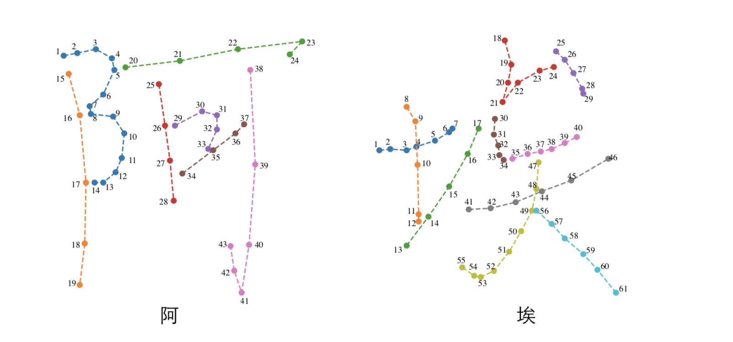
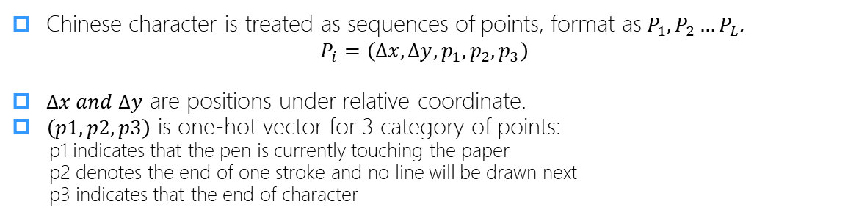
Data Representation
Chinese character is treated as sequences of points, format as$P_{1}, P_{2}…P_{L}$.
$$P_{i}=\left(Δx, Δy, p_{1},p_{2},p_{3}\right)$$
$Δx and Δy$ are positions under relative coordinate.
$\left(p1, p2, p3\right)$ is one-hot vector for 3 category of points:
p1 indicates that the pen is currently touching the paper
p2 denotes the end of one stroke and no line will be drawn next
p3 indicates that the end of character

Slide 5
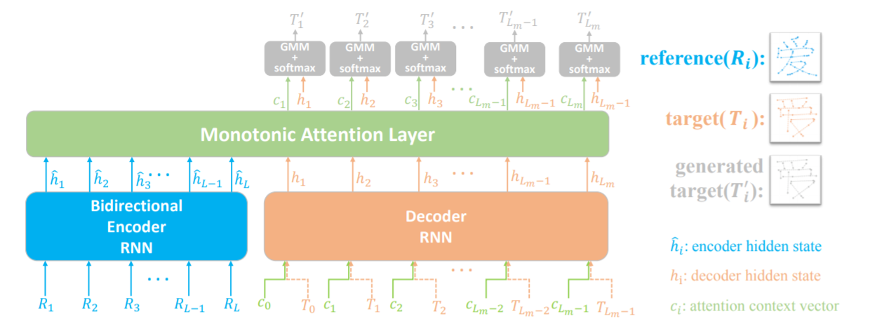
Model Architecture
Based on the task, design a model based on Seq2Seq.
The encoder-decoder Seq2Seq framework is widely employed to a variety of sequence related or generation tasks.

Slide 6
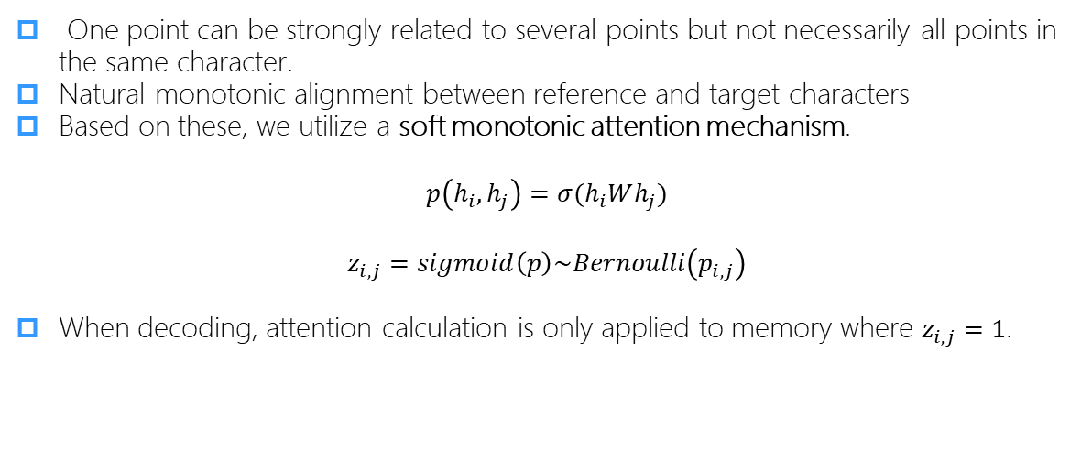
Model Architecture
One point can be strongly related to several points but not necessarily all points in the same character.
Natural monotonic alignment between reference and target characters
Based on these, we utilize a soft monotonic attention mechanism.
$$p\left(h_{i}, h_{j}\right)=σ(h_{i}Wh_{j})$$
$$z_{i,j}=sigmoid\left(p\right)\sim Bernoulli\left(p_{i,j}\right)$$
When decoding, attention calculation is only applied to memory where $z_{i,j}=1$.
Notes:
When decoding, attention calculation is only applied to memory where $z_{i,j}=1$.

Slide 7
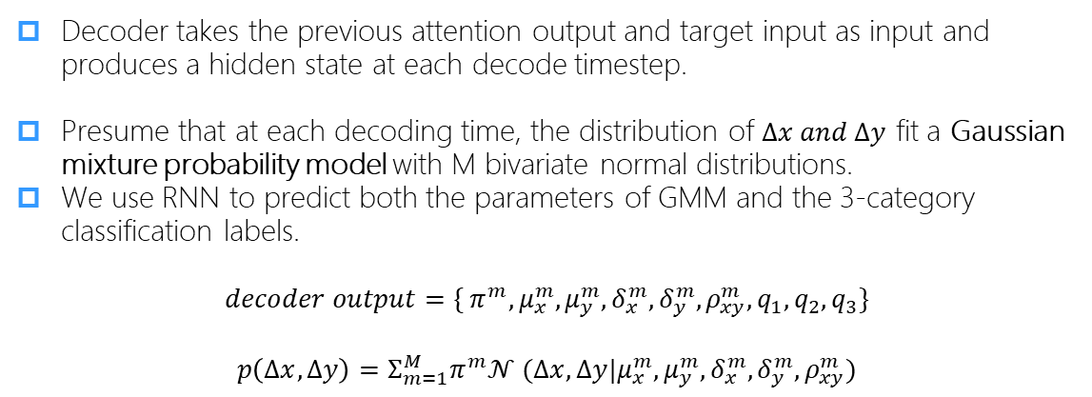
Model Architecture
Decoder takes the previous attention output and target input as input and produces a hidden state at each decode timestep.
Presume that at each decoding time, the distribution of $Δx and Δy$ fit a Gaussian mixture probability model with M bivariate normal distributions.
We use RNN to predict both the parameters of GMM and the 3-category classification labels.
$$decoder output=\{{{ π}^{m},μ}_{x}^{m},μ_{y}^{m},δ_{x}^{m}, δ_{y}^{m},ρ_{xy}^{m},q_{1},q_{2},q_{3}\}$$
$$p\left(Δx, Δy\right)=Σ_{m=1}^{M}π^{m}𝒩 (Δx,Δy|μ_{x}^{m},μ_{y}^{m},δ_{x}^{m}, δ_{y}^{m},ρ_{xy}^{m})$$

Slide 8
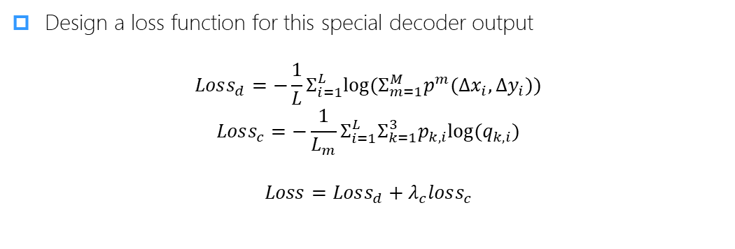
Model Architecture
Design a loss function for this special decoder output
$$Loss_{d}=−\frac{1}{L}Σ_{i=1}^{L}log⁡(Σ_{m=1}^{M}p^{m}(Δx_{i}, Δy_{i}))$$
$$Loss_{c}=−\frac{1}{L_{m}}Σ_{i=1}^{L}Σ_{k=1}^{3}p_{k,i}log⁡(q_{k,i})$$
$$Loss=Loss_{d}+λ_{c}loss_{c}$$

Slide 9
Experiments
We experiment on two dataset, FangZheng font dataset and a handwritten dataset from CASIA database
In the training process, the former one uses 775 samples and the latter one uses 2000 samples, for that handwritten character are far more irregular and difficult to learn.
Our model can generate thousands of unseen characters with small amount of training samples.
Notes:
Comparing the result, we can find that FZ dataset is more consistent and regular than the handwritten dataset, so it needs less training samples to learn the character glyph.

Slide 10
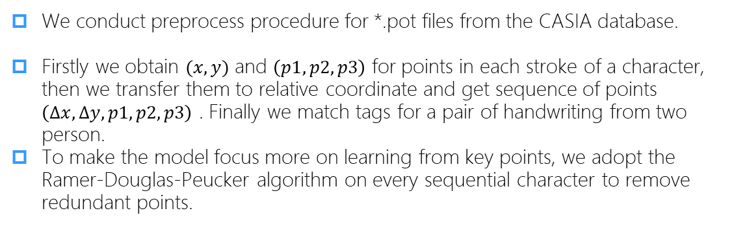
Data Preprocessing for Handwritten Dataset
We conduct preprocess procedure for *.pot files from the CASIA database.
Firstly we obtain $(x, y)$ and $\left(p1, p2, p3\right)$ for points in each stroke of a character, then we transfer them to relative coordinate and get sequence of points $\left(Δx, Δy, p1, p2, p3\right)$ . Finally we match tags for a pair of handwriting from two person.
To make the model focus more on learning from key points, we adopt the Ramer-Douglas-Peucker algorithm on every sequential character to remove redundant points.

Slide 11
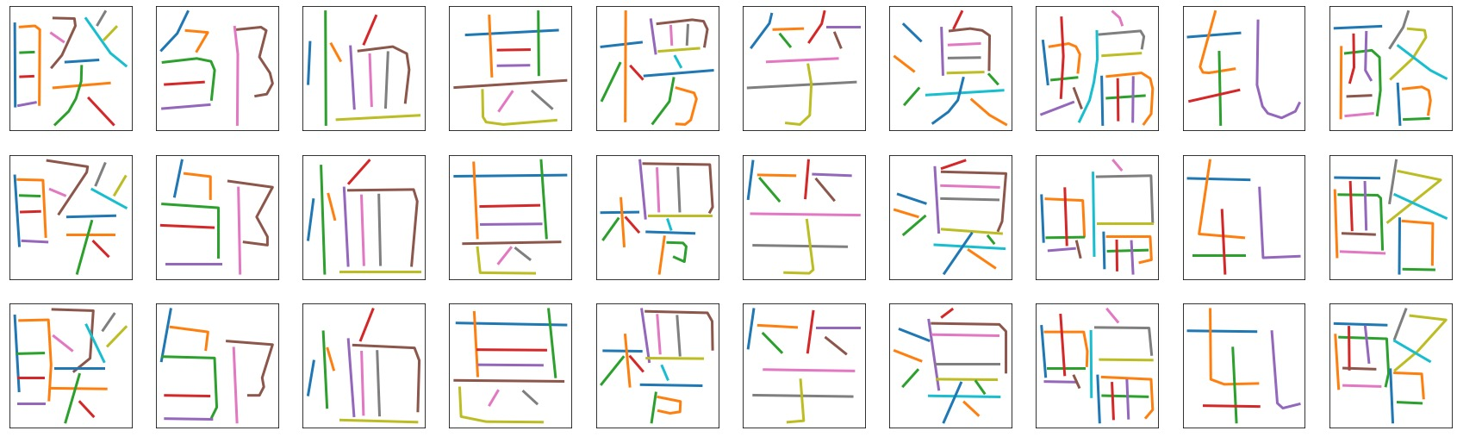
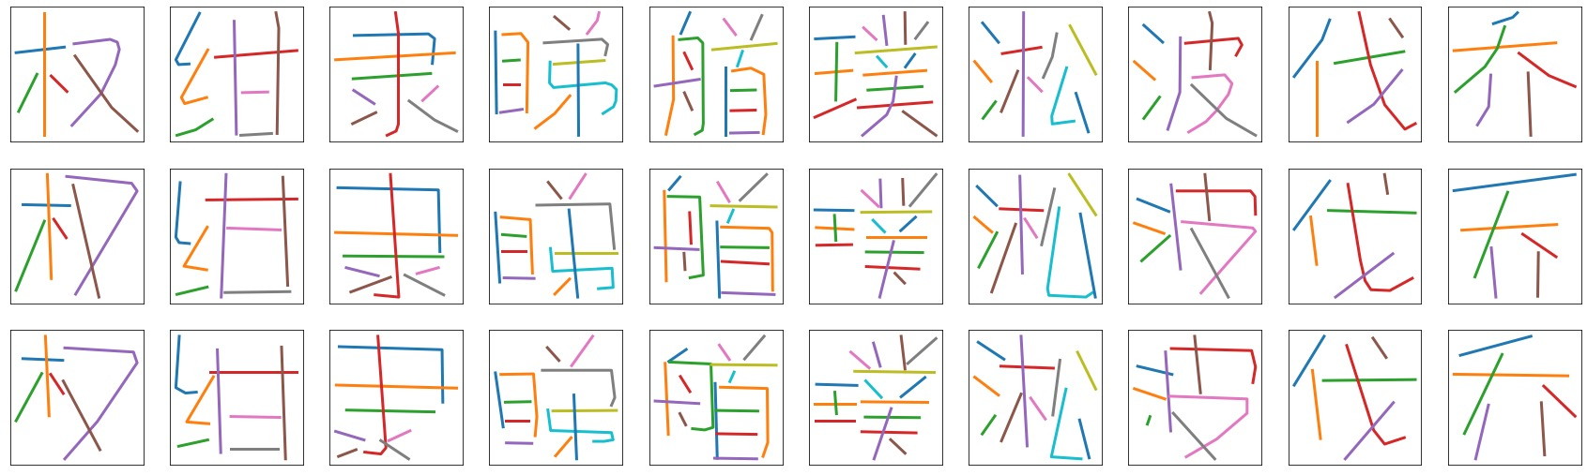
Experimental Results on Font Dataset
Line 1 represents the reference font, line 2 represents ground truth font, line3 represents generated font.

Slide 12
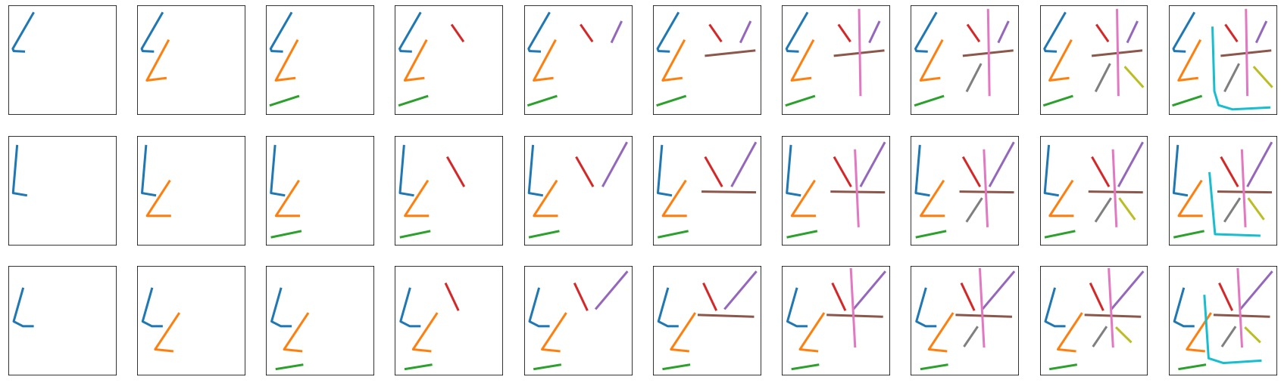
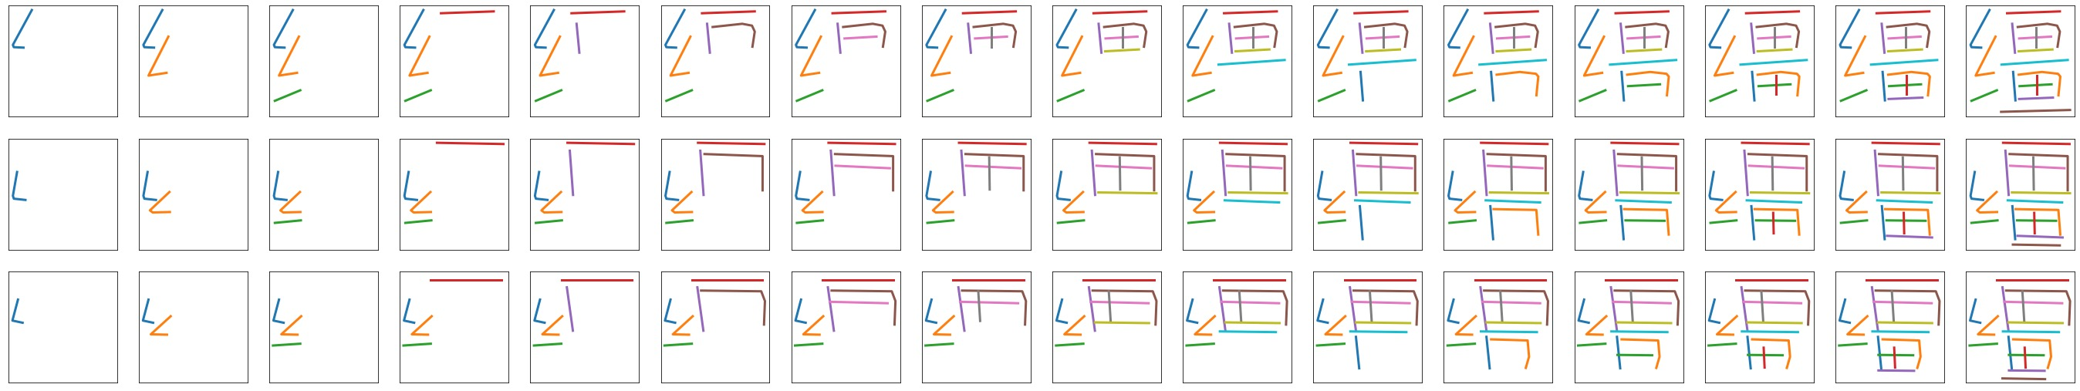
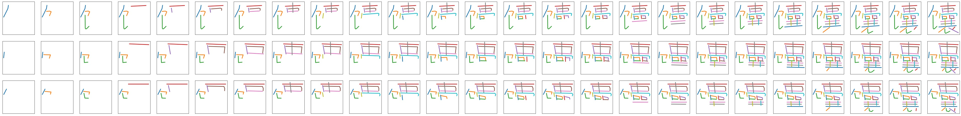
Experimental Results on Font Dataset
Project Name

Slide 13

Experimental Results on Font Dataset

Slide 14
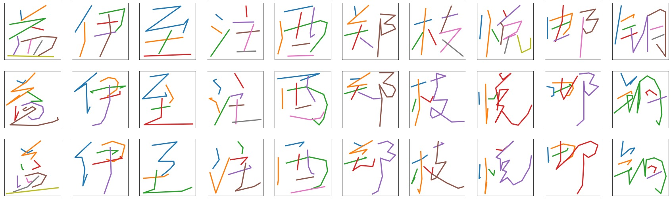
Experimental Results on Handwriting Dataset
Line 1 represents the reference font, line 2 represents ground truth font, line3 represents generated font.

Slide 15

Demo Page for Generated Handwritten Characters
We recommend to open this link from PC

Slide 16
Conclusion
We focus on the sequential characteristic of Chinese character and propose a novel RNN-based model with monotonic attention mechanism
We conduct experiment on two dataset, results show that our model can generalize well on small-scale dataset while cost no performance drop

Slide 17
Future Work
Better data preprocessing technique for handwriting data
Add glyph contour rendering module for characters via CNN
End-to-end Chinese fonts generation
Specialized model design for irregular handwriting data
Production level applications such as writing robots, generating personal handwriting fonts etc.

Slide 18
Reference
GRAVES A.: Generating sequences with recurrent neural net- works. arXiv preprint arXiv:1308.0850, 2013.
FontRNN: Generating Large-scale Chinese Fonts via Recurrent Neural Network. Computer Graphics Forum, 2019.
Generating handwritten chinese characters using cyclegan. arXiv preprint arXiv:1801.08624 (2018).
Sequence to sequence learning with neural networks. In Advances in neural information processing systems (2014), pp. 3104–3112.
Online and linear-time attention by enforcing monotonic alignments. In Proceedings of the 34th International Conference on Machine LearningVolume 70 (2017), JMLR. org, pp. 2837–2846.
Project Name

Slide 19
Thanks for Listening!
Project Name

